Slide 1
CONFERENCE MANAGEMENT SYSTEM
COLLABORATION
SALİH ALİ KAMACI
BATUHAN BAŞAR
GÖRKEM TURKUT
BURAK KARAMEŞE

Slide 2
SOFTWARE ARCHITECTURE
We chose to use layered architecture in this project. The layered architecture reflects the relationship between the components in detail, which we thought was very suitable for this project.
We have divided the layers into 4 groups and explained the contents of the architectural representation, the subsystems and components of the architectural representation, the descriptions of these architectural layers and their relationships with each other.

Slide 3
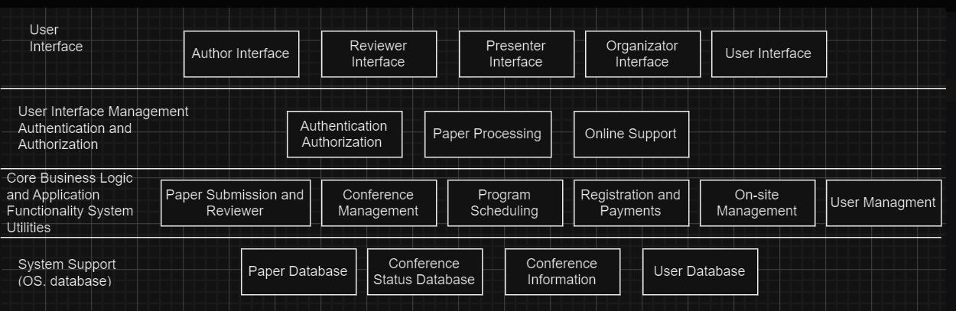
Software Architecture Representation

Slide 4
Architecture Overview
1. User (WEB) Interface Layer:
- Author Interface: Interface used by authors to submit and manage articles.
- Reviewer Interface: Interface used by reviewers to review and evaluate articles.
- Presenter Interface: Interface used by presenters to prepare and manage presentations.
- Organizer Interface: Interface used by conference organizers to manage the conference.
- User Interface: General interface for other user roles.

Slide 5
Architecture Overview
2. Authentication and Authorization & Processing and Support Layer :
- Manages user authentication and authorization processes.
- Provides access control based on user roles and permissions.
- Paper Processing: Manages article submission, reviewer assignment, and review processes.
- Online Support: Provides online support to users.

Slide 6
Architecture Overview
3. Business Logic and Application Functionality Layer:
- Paper Submission and Reviewer: Manages article submission and reviewer review processes.
- Conference Management: Manages conference details and programs.
- Program Scheduling: Manages the scheduling and organization of conference sessions.
- User Management: Manages the creation, administration, and authorization of user accounts.
- Registration and Payments: Manages participant registrations and payment processes.
- On-site Management: Manages events and participants during the conference.

Slide 7
Architecture Overview
4. Database Layer:
- Paper Database: Database where articles are stored.
- Conference Status Database: Database tracking the status of the conference.
- Conference Information Database: Database storing information related to the conference.
- User Database: Database storing user information.

Slide 8
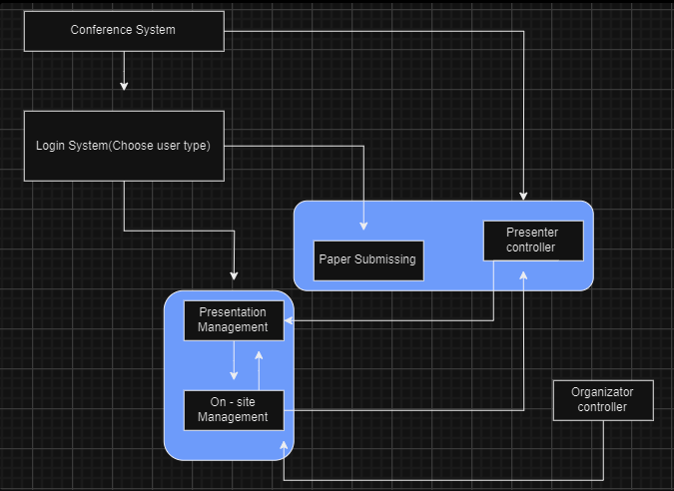
Relationship Diagram

Slide 9
Relationships Between Components and Subsystems
The User Interface interacts with the Authentication and Authorization Layer to enable user login and authorization.
- The Processing and Support Layer interacts with the Business Logic and Application Functionality Layer to facilitate paper processing and online support.
- The Business Logic and Application Functionality Layer interacts with the Database Layer to handle data processing and management.
- The Database layered database allows you to physically see and process data in the background by using functions such as insert and delete to store and update.
This layered architecture enables the modular organization of different functions within the system, enhancing overall performance and ease of maintenance. The block diagram visually represents the system architecture, showing components, subsystems, and their relationships:

Slide 10
Relationships Between Components and Subsystems
User Interface Layer: Interfaces used for user interaction, customized for different user roles.
Authentication and Authorization Layer: Manages user authentication and authorization, enabling secure user access and access controls.
Business Logic and Application Functionality Layer: Contains core business logic and application functionalities, including paper processing, conference management, and user management.
Database Layer: Provides data management and storage, including databases for papers, conferences, users, and related data. Each layer and subsystem interact with each other as shown in the block diagram. For example, user interfaces direct users to the authentication and authorization layer, while the business logic and application functionality layer interacts with the database layer to handle data processing and management. These relationships demonstrate collaboration between components and data flow within the system.

Slide 11
Between layered architectural design and implementation
User Interface Layer:We develop the user interface layer to provide customized interfaces for different user roles. Using web development technologies such as HTML, CSS, and JavaScript, we practically create these interfaces.
Authentication and Authorization Layer:We create the authentication and authorization layer to enable users to securely log into our system and manage access controls. This layer is implemented within the application code, where we encode and apply user authentication and authorization processes according to security standards.
Business Logic and Application Functionality Layer:We establish the business logic and application functionality layer, which encompasses core business logic and application functions. This layer is implemented within the application code, where we code and implement functions such as user management, article processing, conference management, and other functionalities.
Database Layer:We create the database layer to provide data storage and management. We create and manage databases using appropriate database management systems. We apply the data model according to the theoretical design and ensure data integration.
Each layer and subsystem is developed according to specified requirements and design principles. The application is coded and tested based on the theoretical design, considering practical feasibility and performance. Throughout each stage of application development, we ensure alignment and consistency between design and implementation, making improvements as necessary to meet system requirements. This process facilitates the transition from theoretical design to a practical system implementation.

Slide 12
UI Design Overview
In designing the user interface (UI) for a conference management system, several key criteria are typically considered to ensure an intuitive, user-friendly, and efficient experience for both conference organizers and attendees.

Slide 13
UI Design Principles
User-Centered Design: Prioritize user needs and goals.
Clarity and Simplicity: Keep the interface clean and easy to understand.
Consistency: Use consistent design elements and interaction patterns.
Information Hierarchy: Display important information prominently.
Visual Hierarchy: Use visual cues to guide attention.
Accessibility: Ensure the interface is usable by everyone.
Feedback and Error Handling: Provide immediate feedback to users.
Responsive Design: Make sure the UI works well on all devices.
User Feedback and Iteration: Improve the UI based on user input.
Security and Privacy: Protect user data and ensure secure transactions.

Slide 14



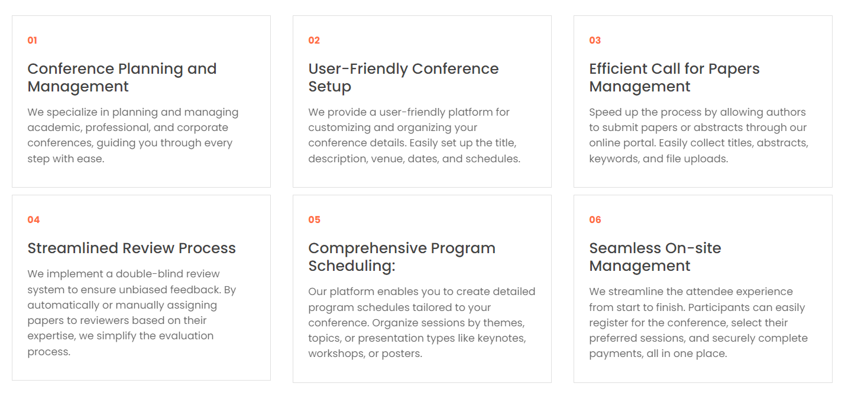
Main Page Screenshots

Slide 15
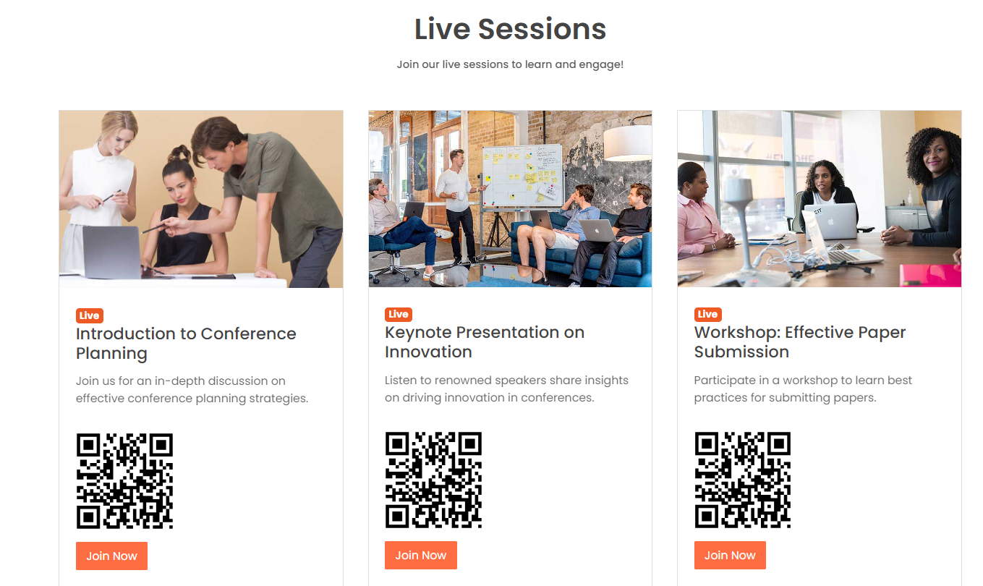
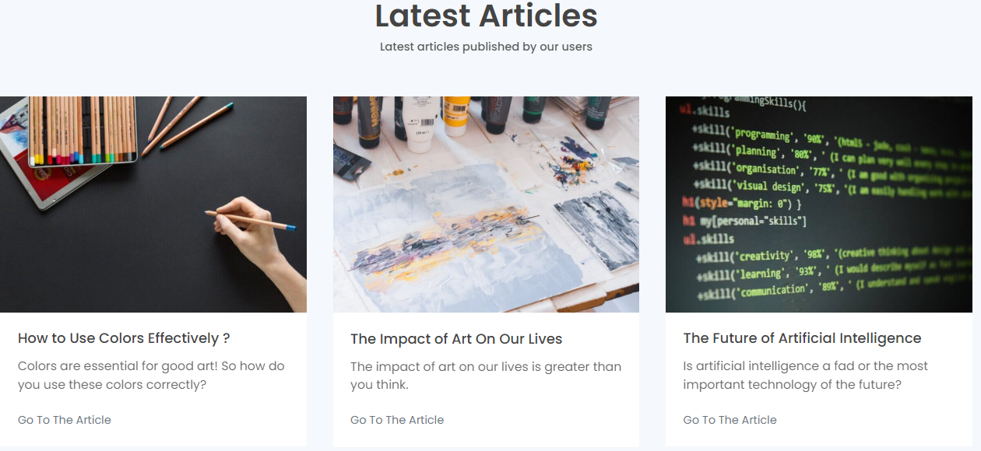
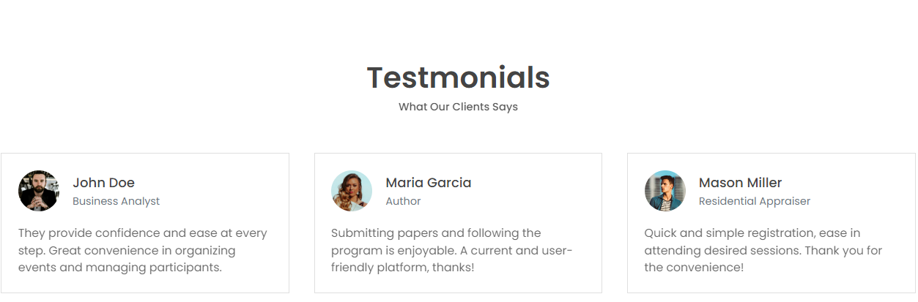
Main Page Screenshots

Slide 16
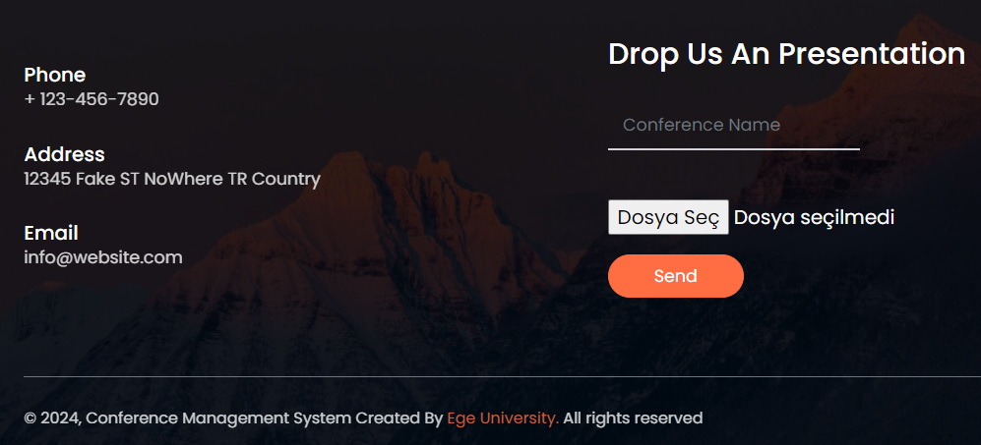
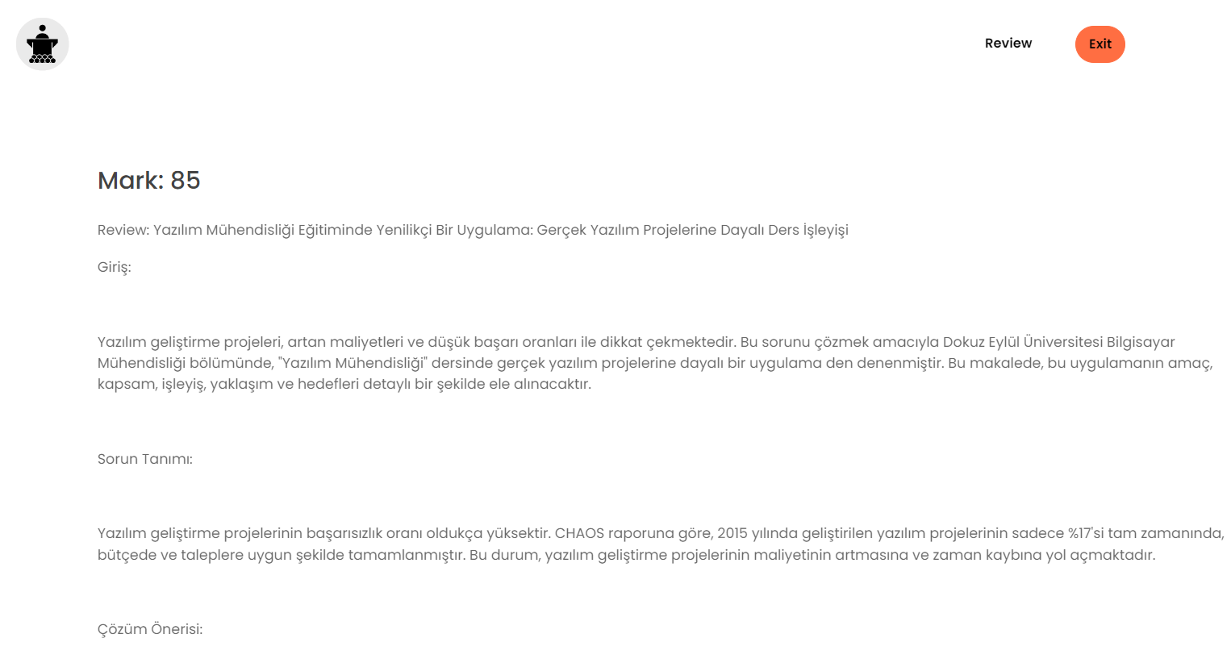
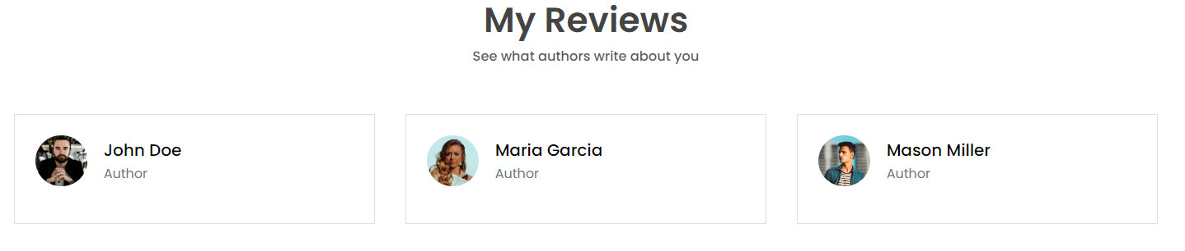
Author Screenshots

Slide 17

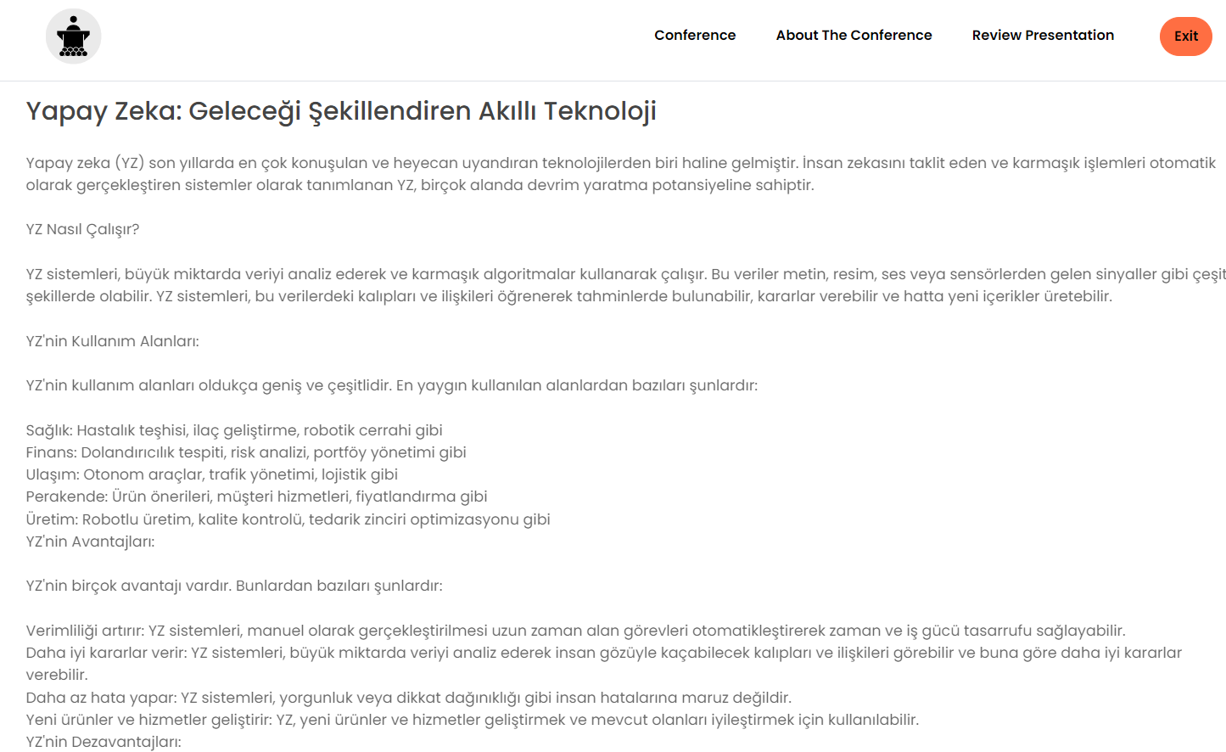
Reviewer Screenshots

Slide 18
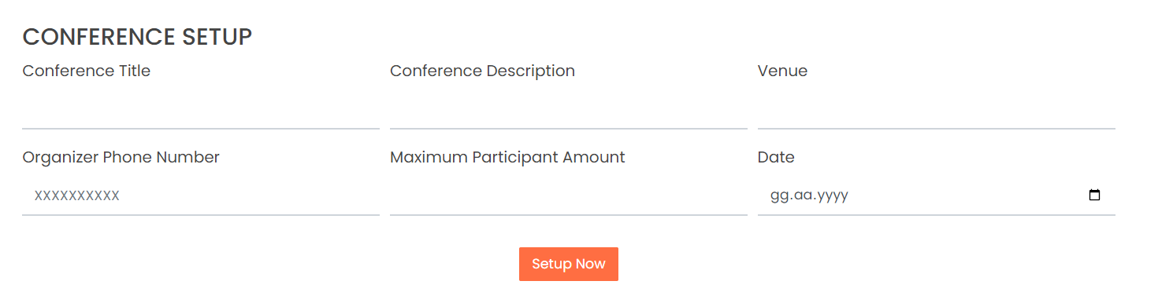
Organizator Screenshots

Slide 19
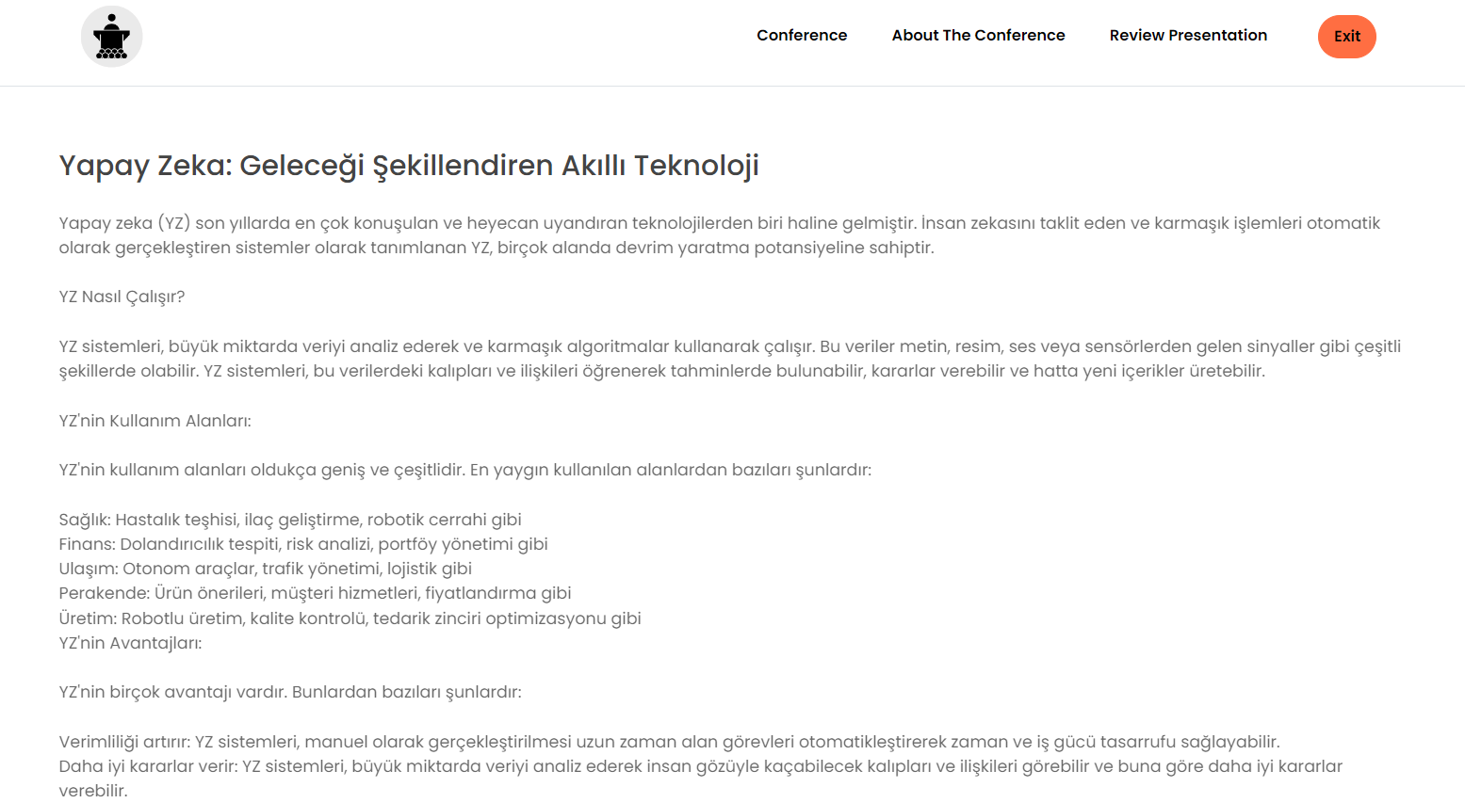
User Screenshots

Slide 20
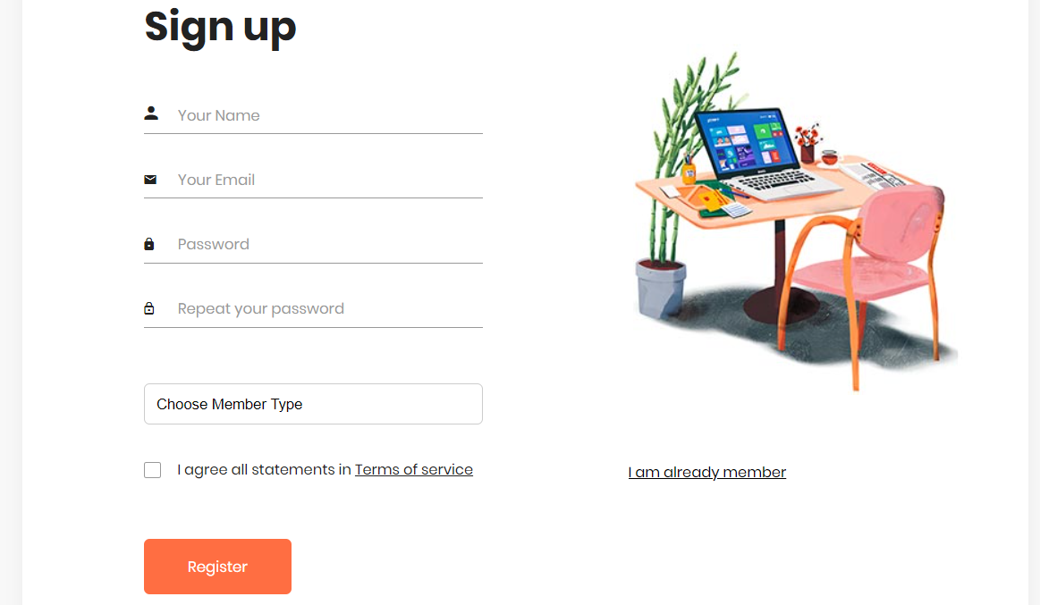
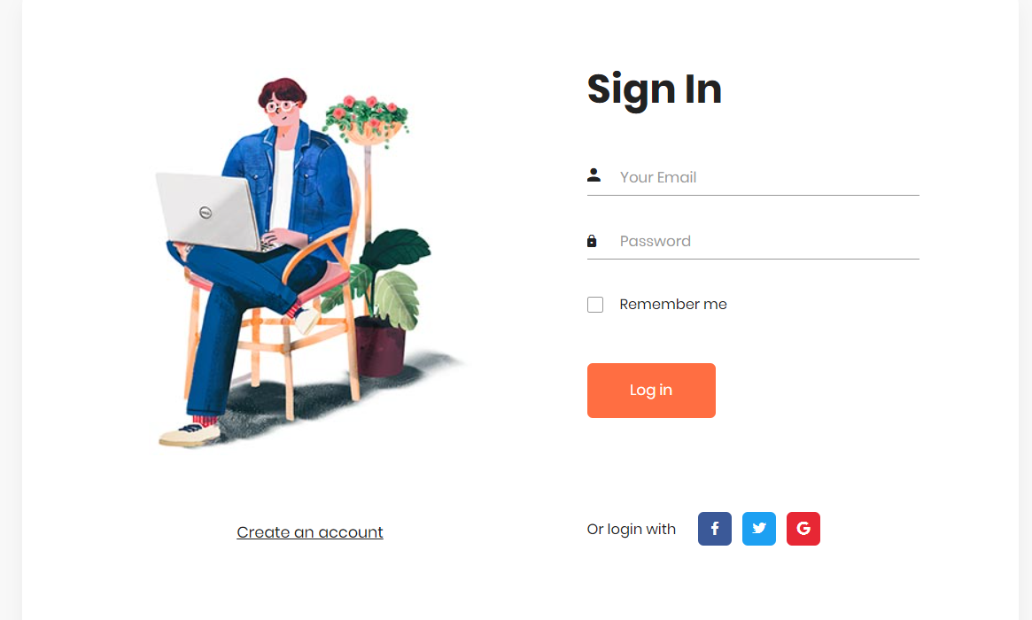
Login Screenshots

Slide 21
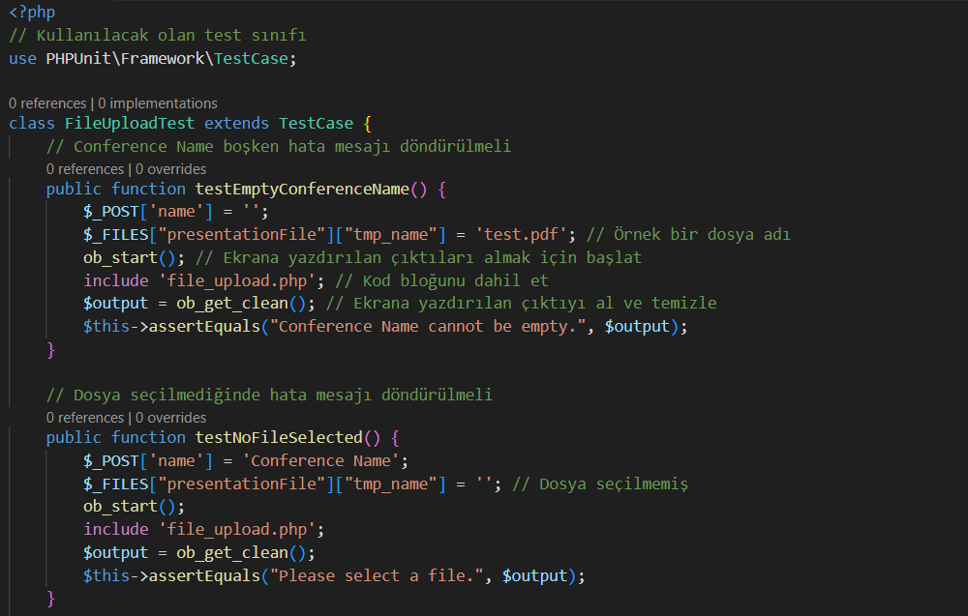
Testing Overview

Slide 22
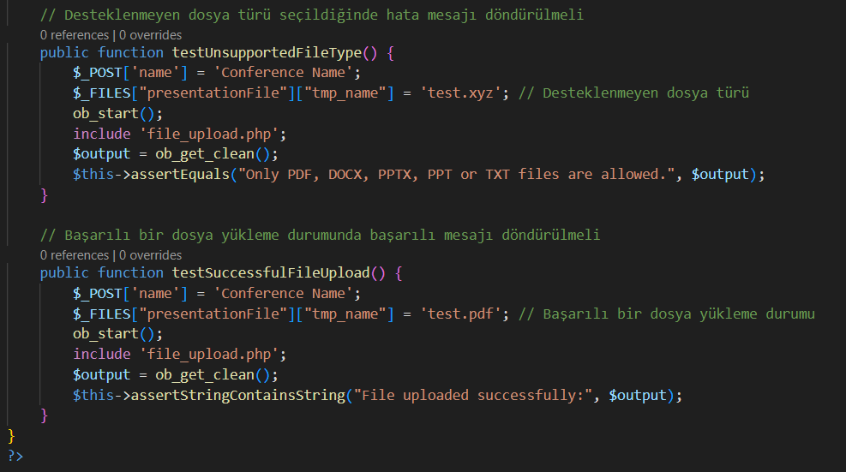
Testing Overview

Slide 23
Testing Overview
FileUploadTest Class:
Empty Conference Name: If the conference name is empty, an error message should be returned.
No File Selected: If no file is selected, an error message should be returned.
Unsupported File Type: If an unsupported file type is selected, an error message should be returned.
Successful File Upload: In case of a successful file upload, a success message should be returned.

Slide 24
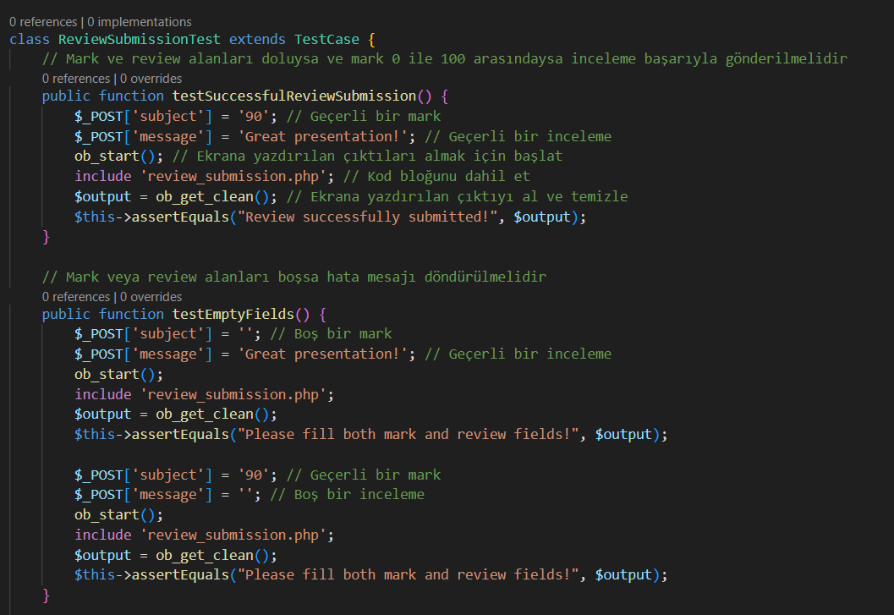
Testing Overview

Slide 25
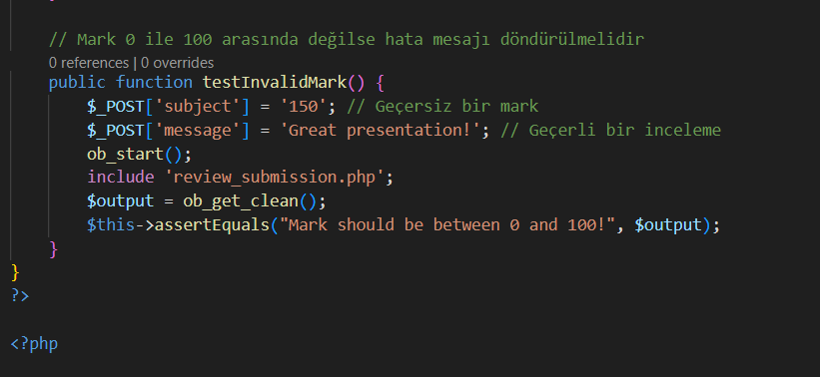
Testing Overview

Slide 26
Testing Overview
ReviewSubmissionTest Class:
Successful Review Submission: If both mark and review fields are filled and the mark is between 0 and 100, the review should be successfully submitted.
Empty Fields: If either mark or review fields are empty, an error message should be returned.
Invalid Mark: If the mark is not between 0 and 100, an error message should be returned.

Slide 27
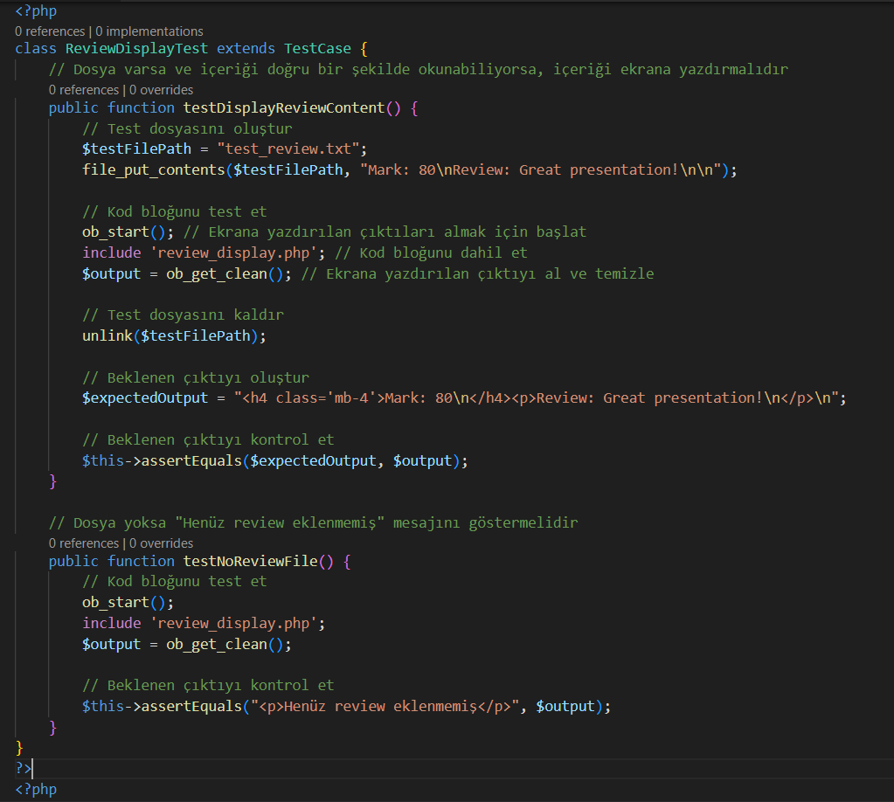
Testing Overview
ReviewDisplayTest Class:
Display Review Content: If a file exists and its content can be read correctly, it should display the content properly.
No Review File: If no review file exists, it should display the message "No review has been added yet."

Slide 28
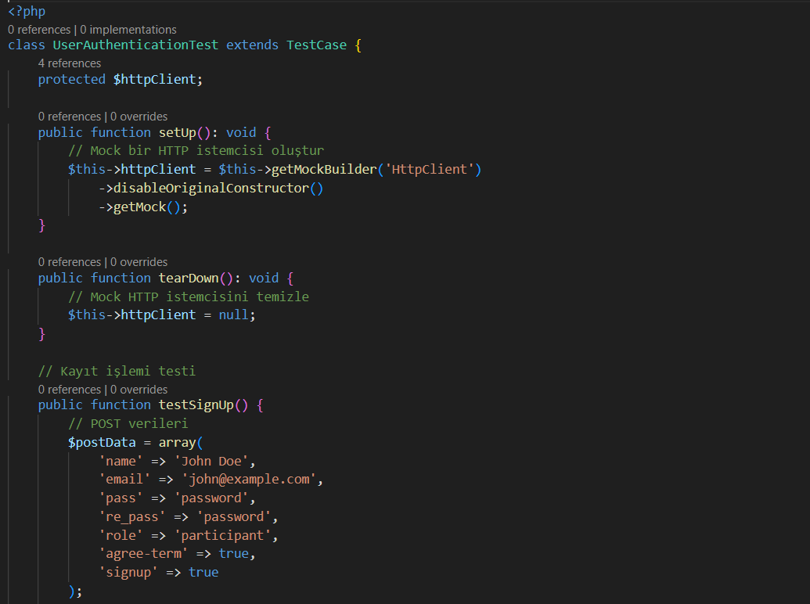
Testing Overview

Slide 29
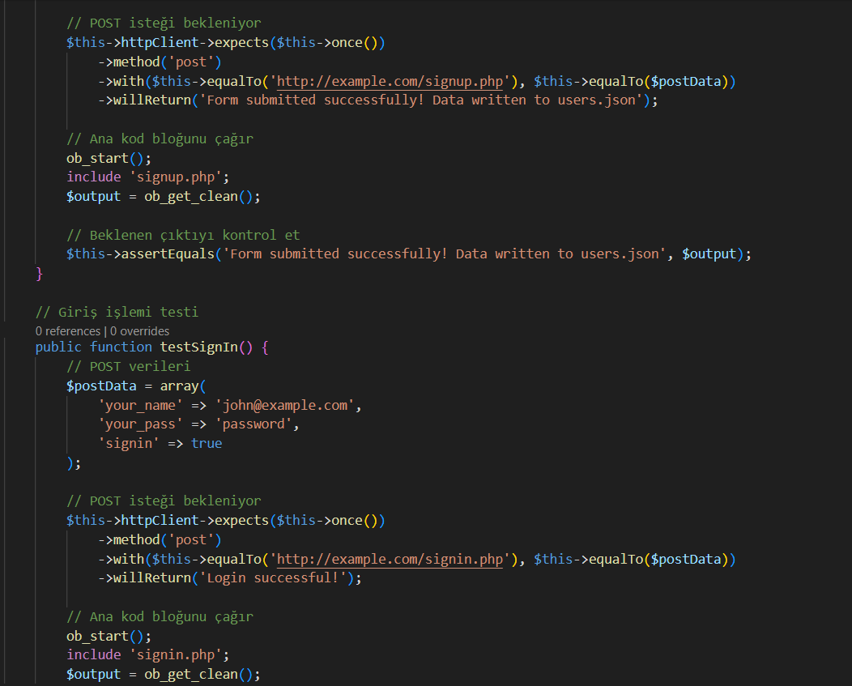
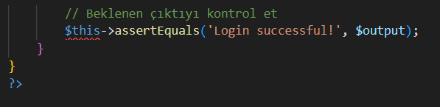
Testing Overview
UserAuthenticationTest Class:
Sign Up Process: If the sign-up process is successful, a success message should be returned.
Sign In Process: If the sign-in process is successful, a success message should be returned.

Slide 30
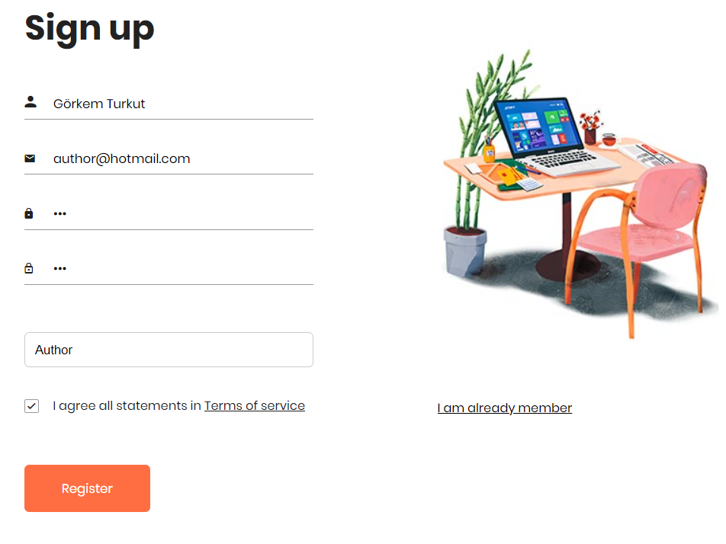
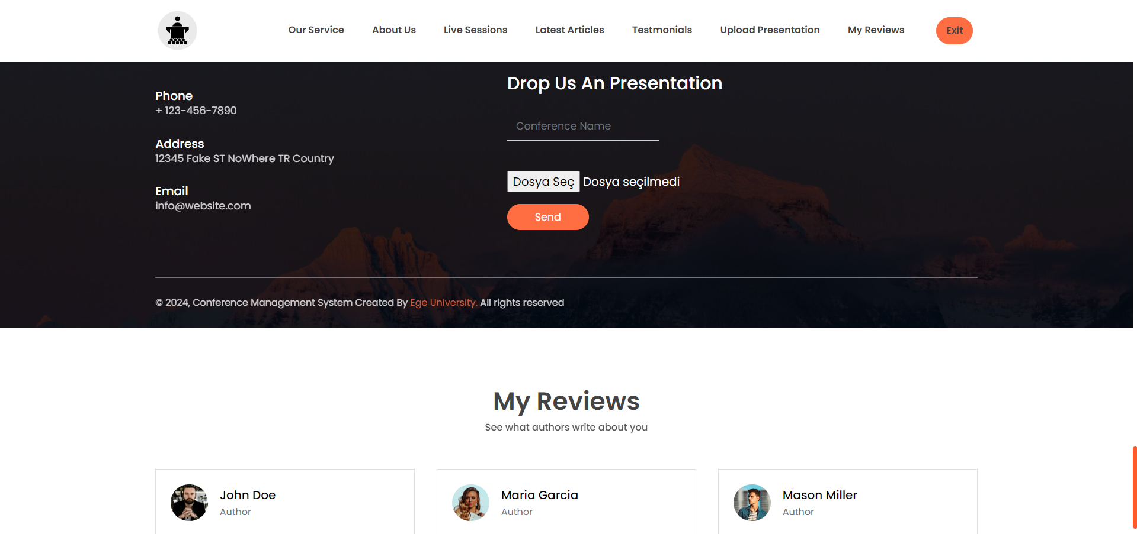
Author Login Case

Slide 31
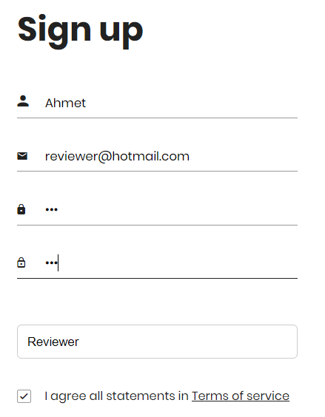
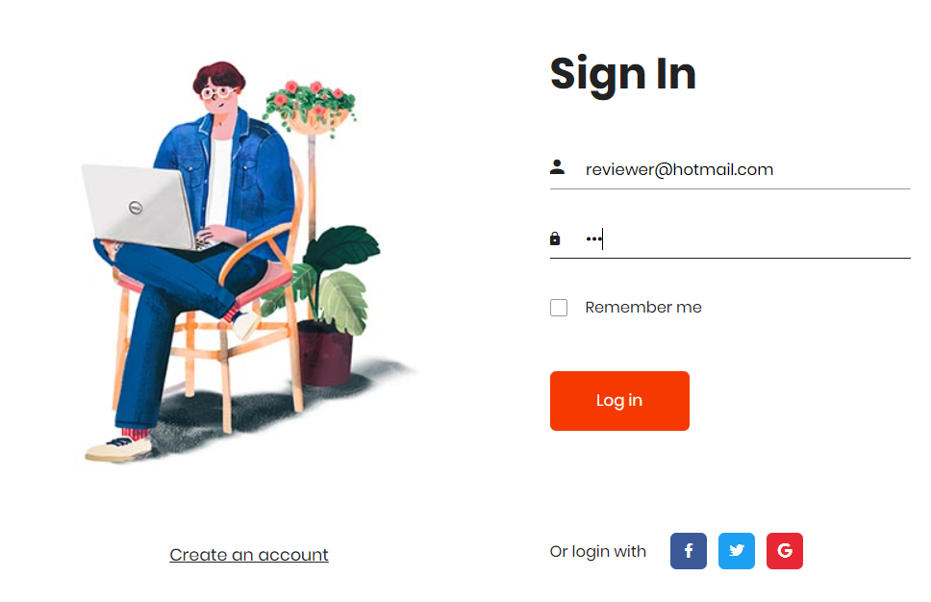
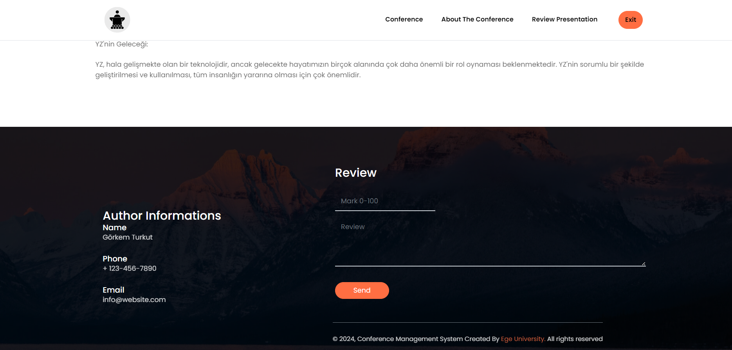
Reviewer Login Case

Slide 32
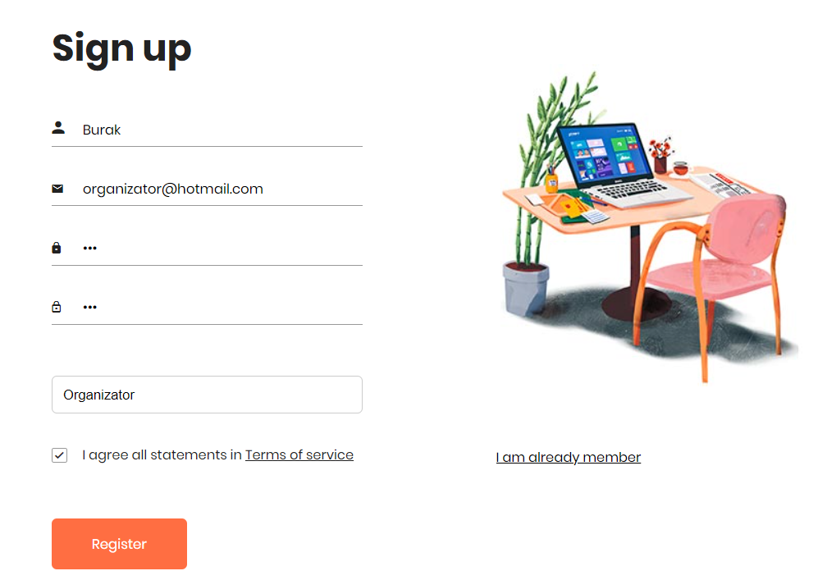
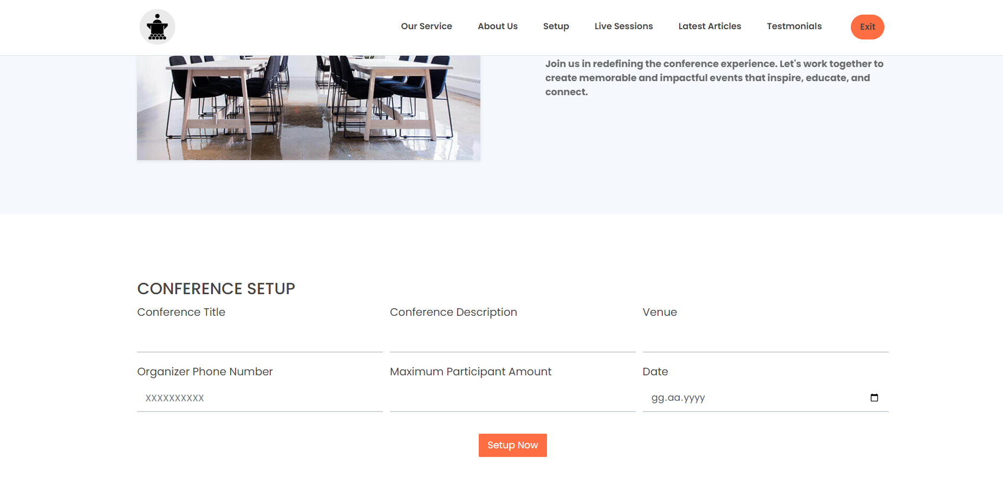
Organizator Login Case

Slide 33
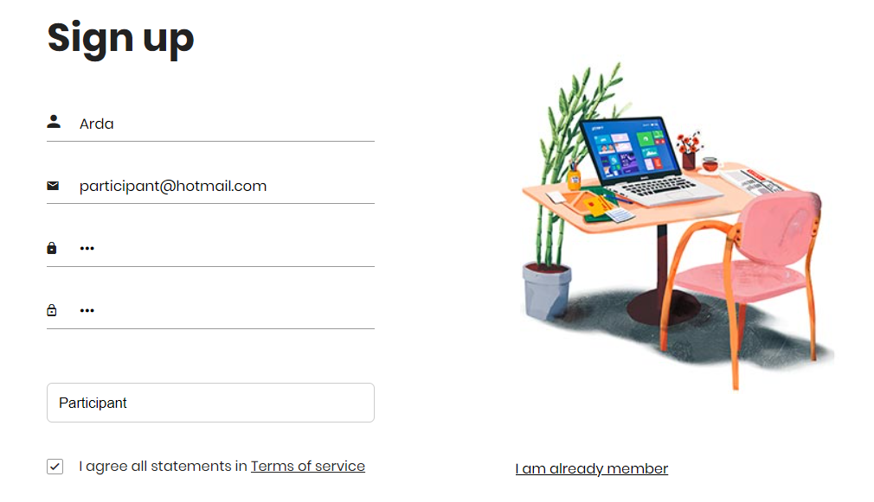
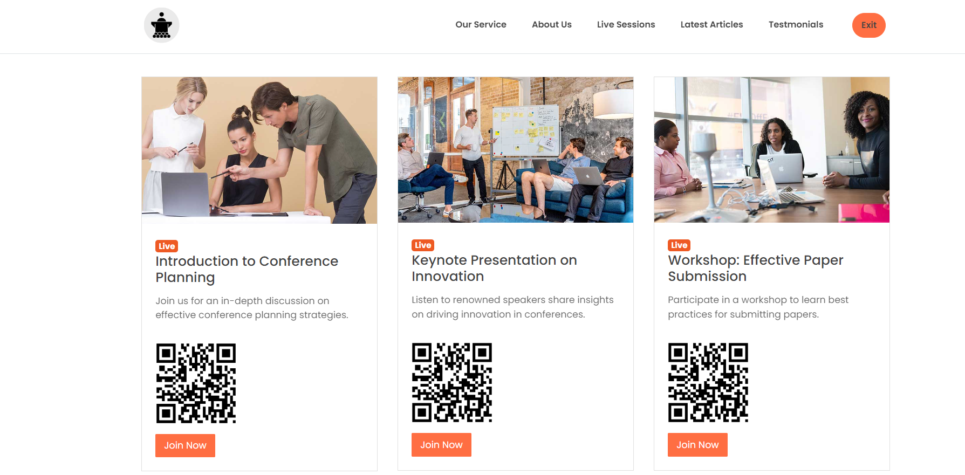
User Login Case

Slide 34
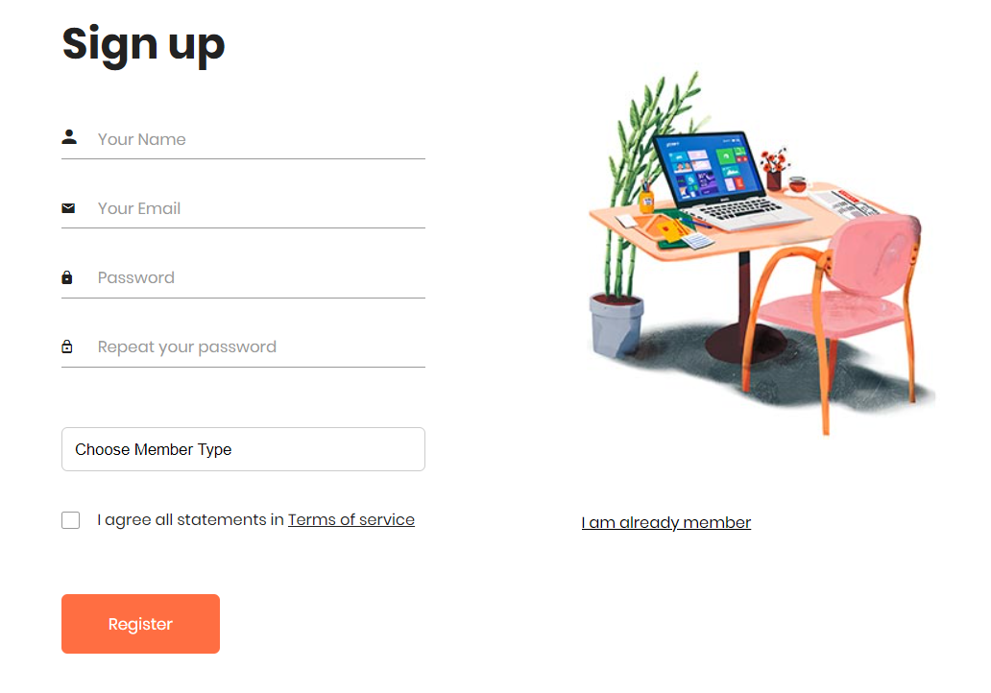
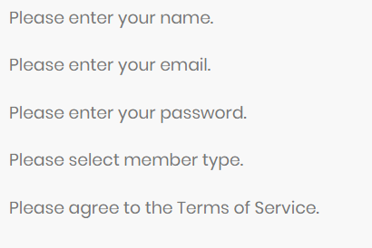
Failed Sign Up Case

Slide 35
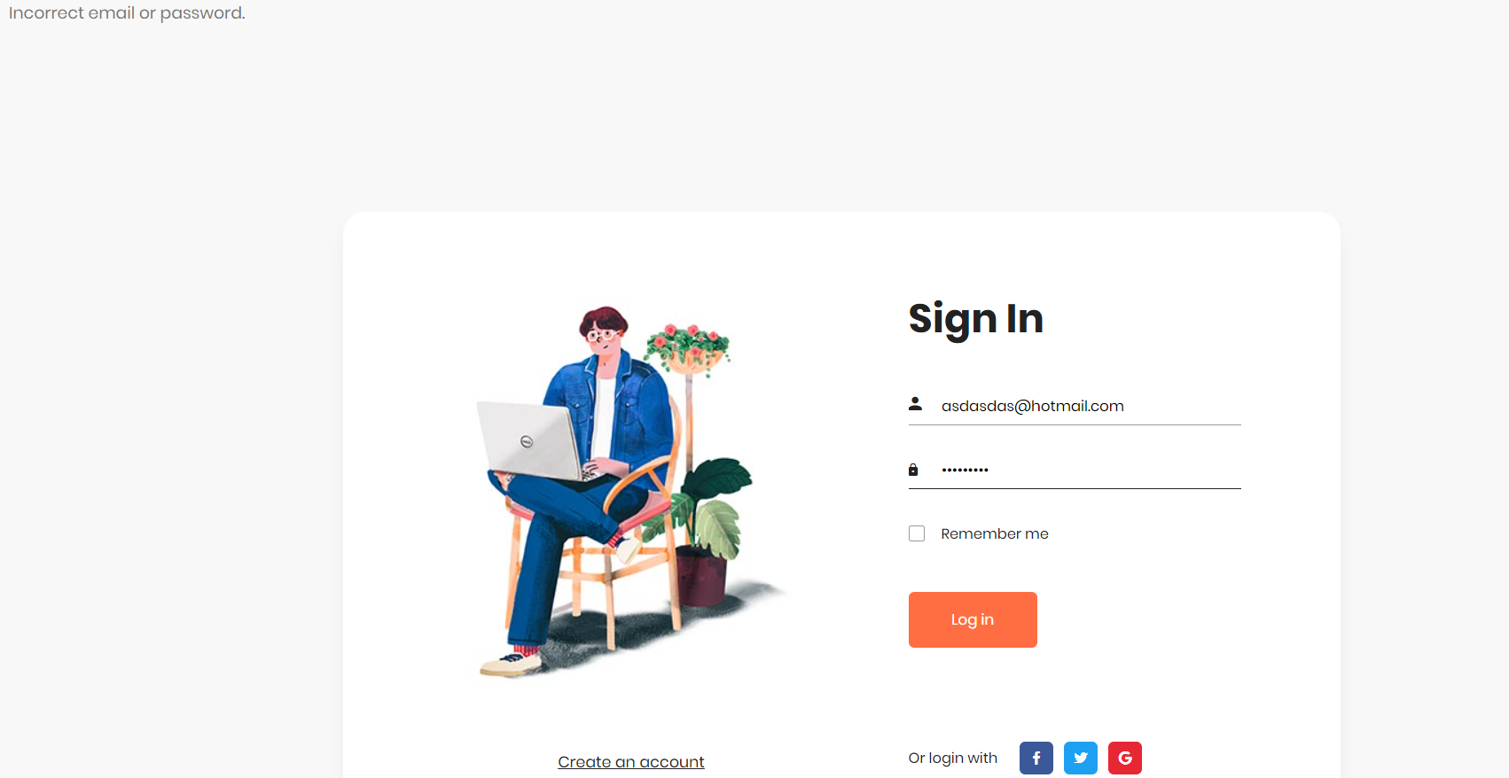
Failed Sign In Case

Slide 36
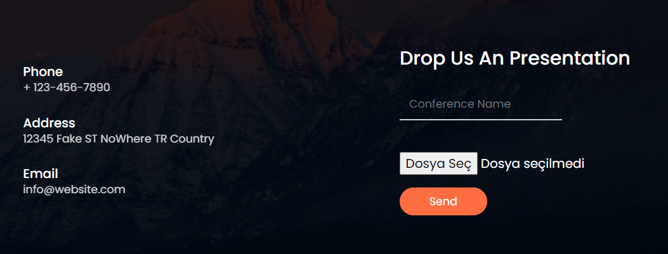
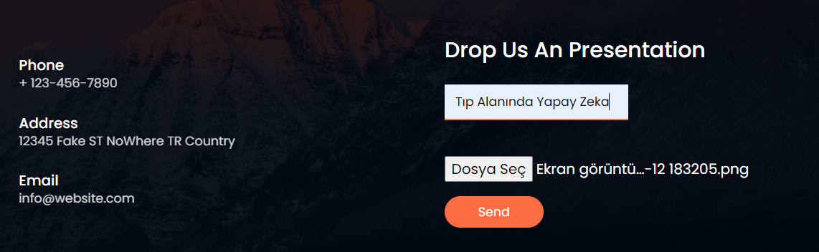
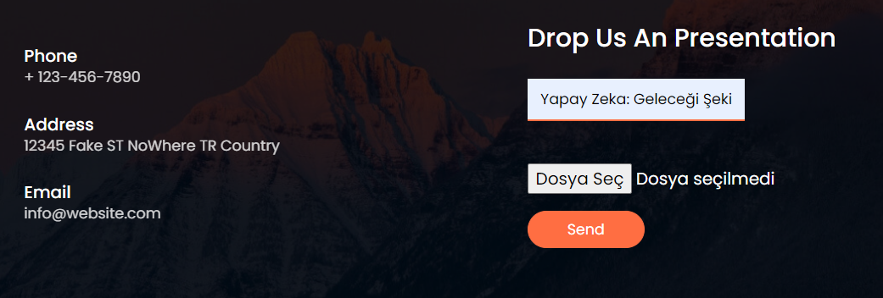
Failed File Upload Cases

Slide 37

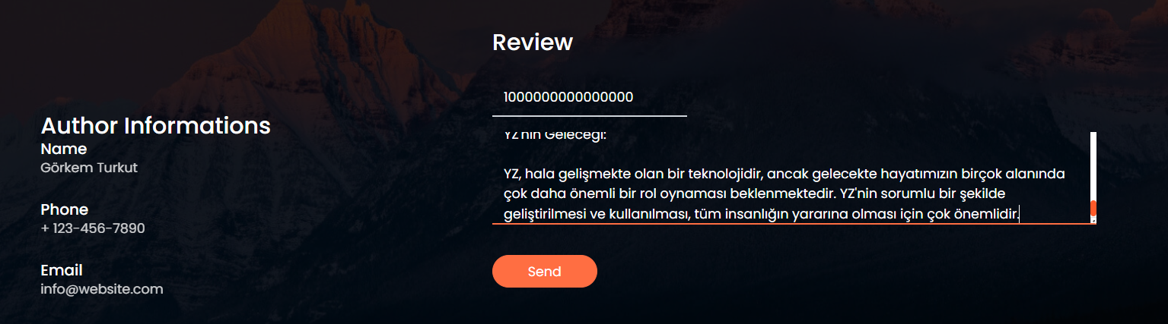
Failed Review Cases

